Slide 1


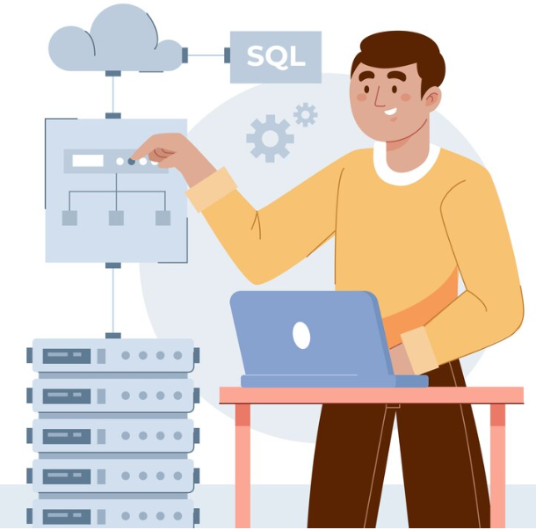
SQL Revision

Slide 2

Agenda
01
Exception Handling
02
Triggers
03
Indexes

Slide 3

Exception Handling
Exception handling in SQL Server is the process of dealing with errors or exceptions that occur during the execution of SQL code.
ERROR_LINE()
ERROR_MESSAGE()
ERROR_PROCEDURE()
ERROR_NUMBER()
ERROR_SEVERITY()
ERROR_STATE()

Slide 4

Triggers
A trigger is defined to activate when a statement inserts, updates, or deletes rows in the associated table.
Points to Remember
Triggers cannot be manually invoked or executed.
There is no chance that triggers will receive parameters.
A transaction cannot be committed or rolled back inside a trigger.
Trigger should not commit and cannot commit.

Slide 5
Triggers
DML - Insert, Update, Delete
DDL - Create, Alter, Drop, Logon
After
Instead of
For
DML Triggers
DDL Triggers

Slide 6
Indexes
Difference between Clustered & Non-Clustered Indexed
Clustered Index | Non-Clustered Index
It determines the physical order of data rows in a table. | It is a separate data structure that contains a copy of the indexed columns in a specific order.
Each table can have only one clustered index. | A table can have multiple non-clustered indexes.
Since a table can have only one clustered index, it is often chosen for the primary key of the table. | Non-clustered indexes store a reference to the clustered index or the actual data row.

Slide 7


Any Questions?

Slide 8

© Copyright Intellipaat. All rights reserved.

